Slide 1
How-to guide for dataplotter
Steps to Set-up and Use
David Wolfson

Slide 2

On Test Stands (already installed)
Double click on this file to start the application

Slide 3
To Install on personal laptop
Save this file onto your computer in some location (for example, the desktop)
Open a command line in the location you saved the file
This can be done by holding down the shift key and right-clicking, then choose “Open PowerShell window here”
Type in this command: python –m pip install dataplotter-1.0.1.tar.gz
This will automatically create the icon shown in the slide above, so simply double click on the icon to open the application

Slide 4
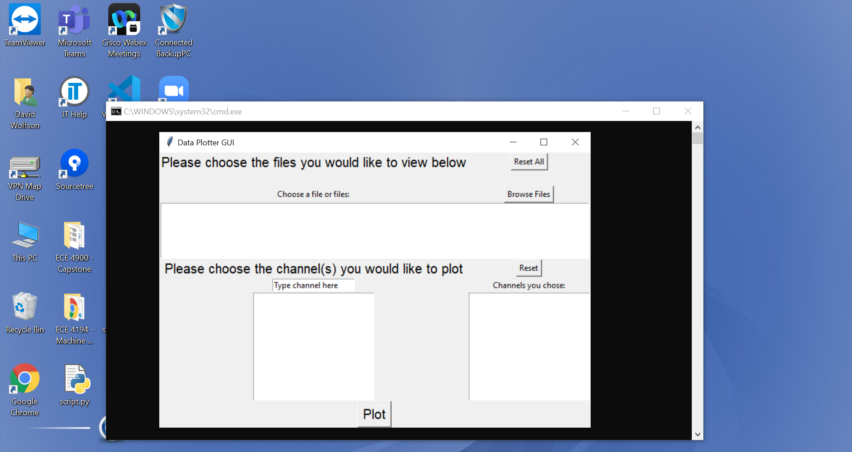
This is what the application looks like

Slide 5
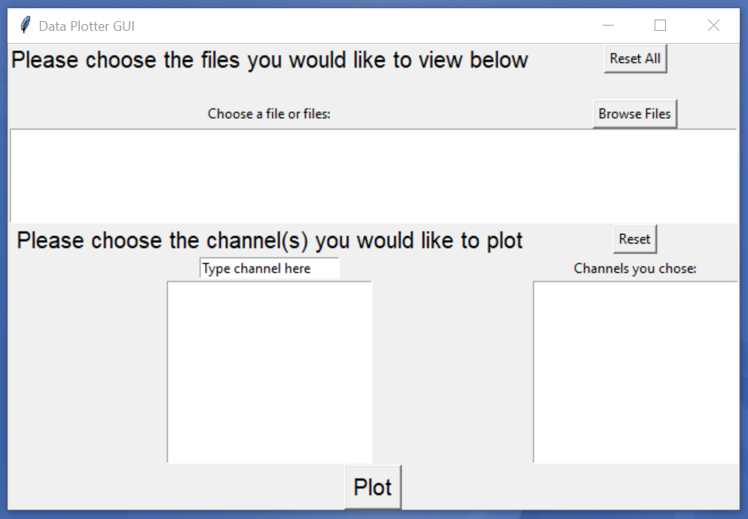
Click this button to select the desired files

Slide 6
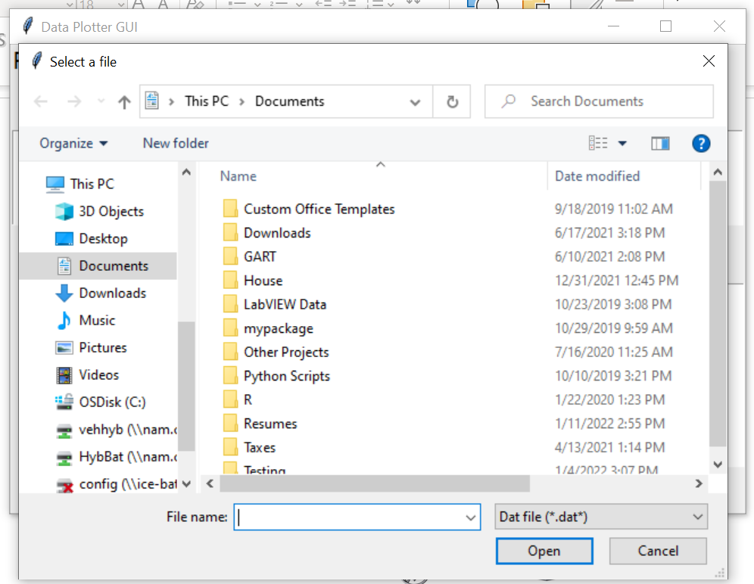
This File Explorer tab will pop up

Slide 7
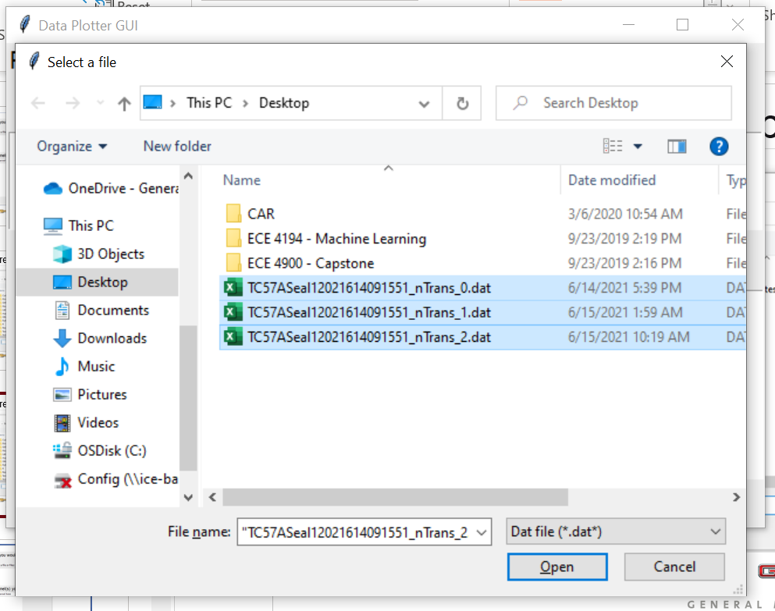
Navigate to the files you would like to select
Select the files by holding down the control button and clicking them. They will automatically be highlighted in blue when selected
Press “Open” button when done

Slide 8
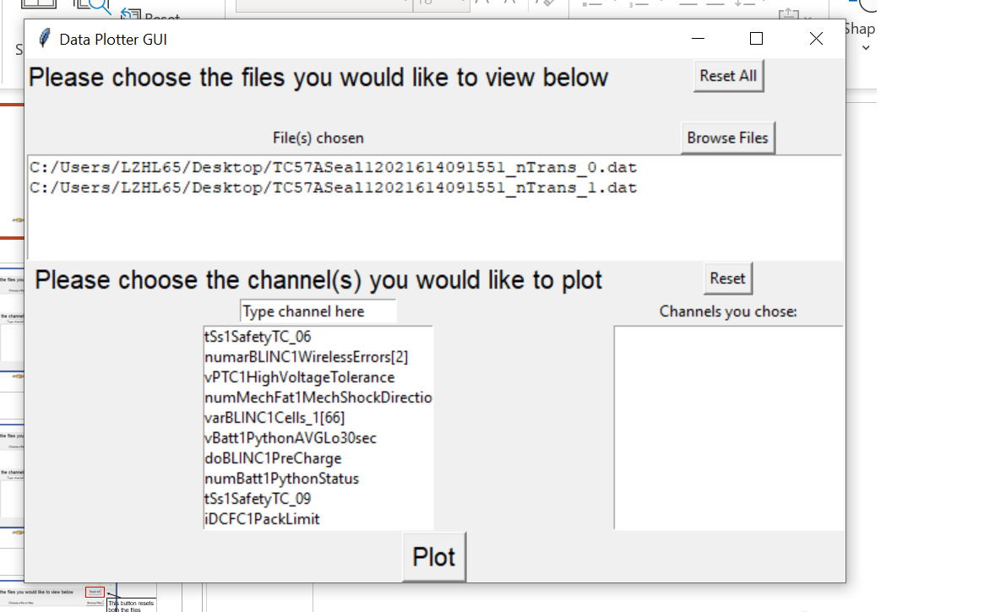
Once files are selected, they will populate here
The list of channels for those files will populate here

Slide 9
To select the desired channels to plot, first highlight and delete “Type channel here” in the search box
Then, begin typing the name of the channel in the search box

Slide 10
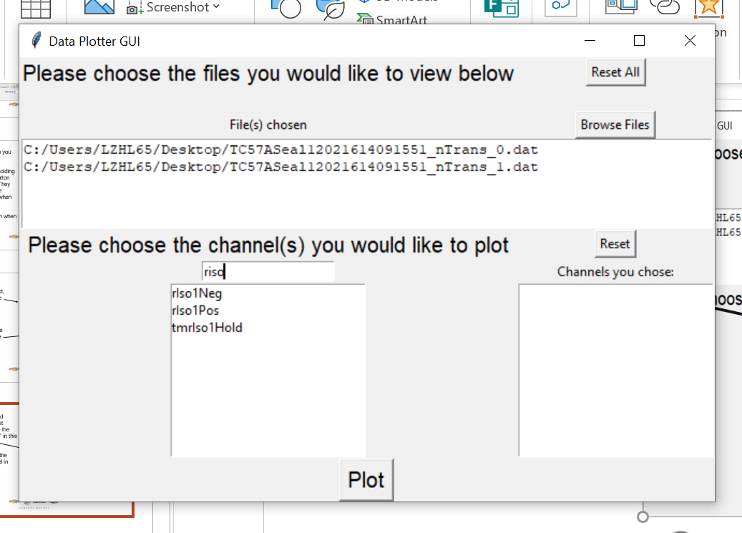
The list of channels will be filtered according to what has been typed
For example, “riso” has been typed in and the channels are automatically filtered to the channels that include “riso”

Slide 11
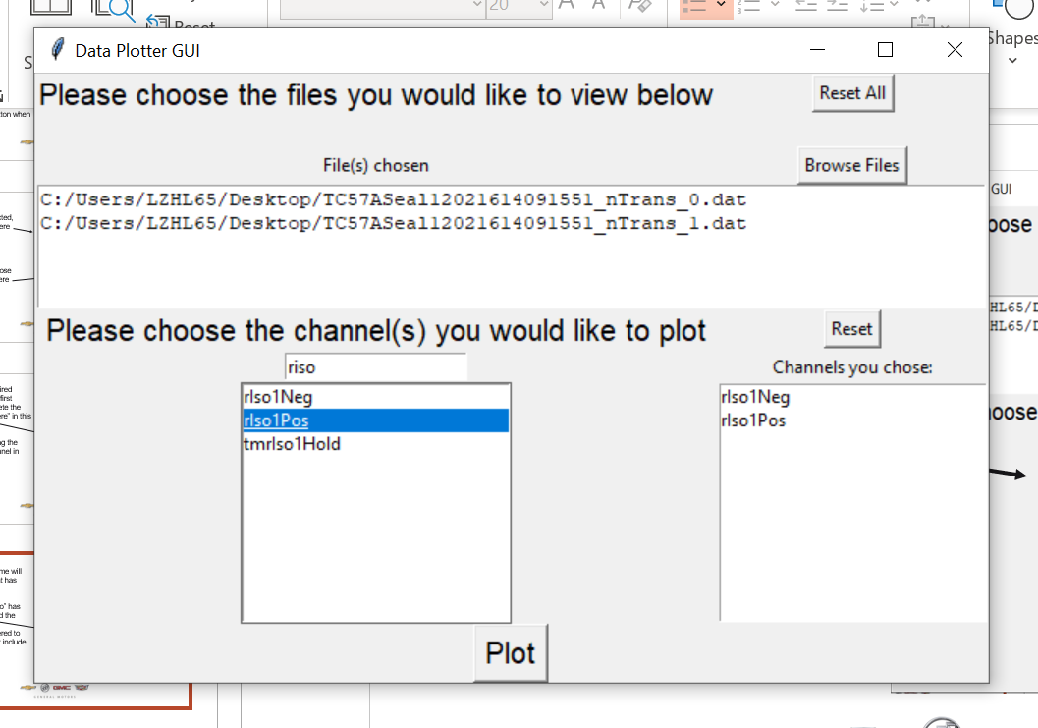
To select a channel, simply double click on it
Once it is selected, it will populate in the box titled “Channels you chose”
Any number of channels can be selected. There is no maximum number of channels

Slide 12
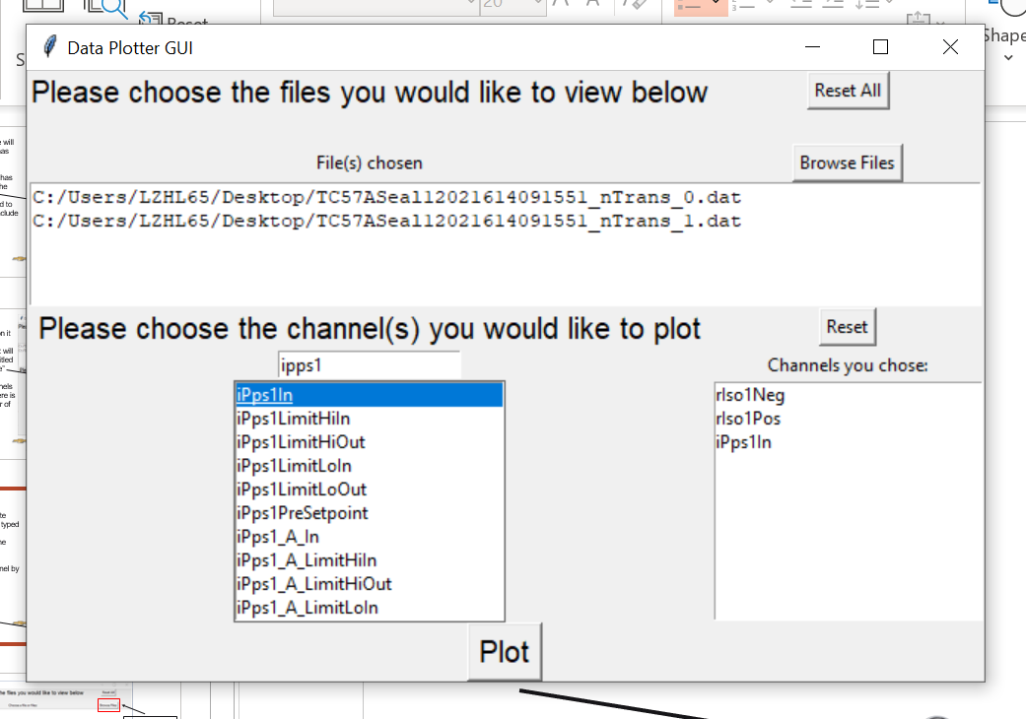
To select a different channel, simply delete what was previously typed in the search box and begin typing the name of the new channel
Select the new channel by double clicking it (same as before)

Slide 13
Click the “Plot” button the plot the data

Slide 14
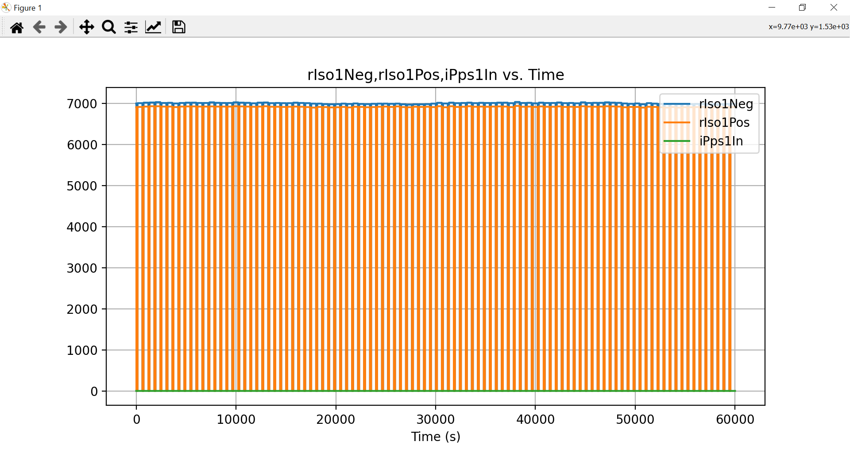
This is the graph of the channels selected
NOTE: All the channels are plotted versus time. This means that time, in seconds, will always be the X-axis, and the channels selected will be on the Y-axis

Slide 15
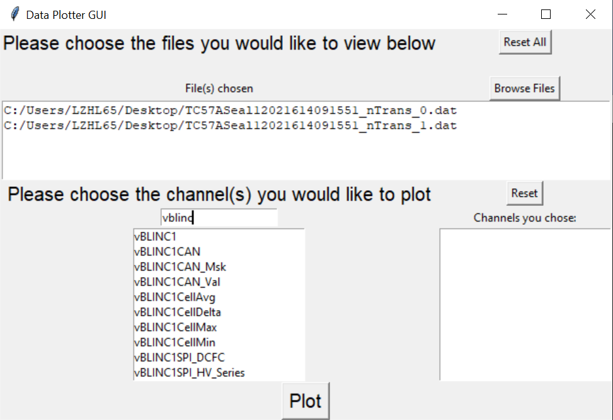
To generate a new plot, simply exit out of the old plot
If you want to plot different channels, click the “reset” button. This will reset the channels selected. Then search for the new channels, add them, and plot the data as explained above
If you want to add channels to the old plot, simply type them in to the search bar, add them and plot the data as explained above

Slide 16
This button resets both the files and the channels

